Slide 1
ITAI 2277 · SPRING 2026
CompoundIQ
Phase 2: Data Pipeline & Exploratory Analysis
Weeks 4 – 6 | Drug Combination Safety Analysis
Nicole Marcial · Oluchi Obinna · Oyinade Balogun · Sharise Griggs

Slide 2
Phase 2 Overview
WEEK 4
WEEK 5
WEEK 6
Data Acquisition & Collection
Preprocessing & Feature Engineering
Exploratory Data Analysis
Identify & access data sources
Implement data collection methods
Data storage & organization
Privacy & ethical considerations
Begin data documentation
Data cleaning & quality assessment
Feature engineering for project needs
Data transformation pipelines
Train / Validation / Test splitting
Continue documentation
Statistical analysis & visualization
Pattern identification
Baseline model creation
Insights documentation
Prepare data milestone deliverable
Datasets Used: DrugBank (XML) · TWOSIDES (NSIDES) · SIDER · ChEMBL · ZINC

Slide 3
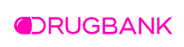
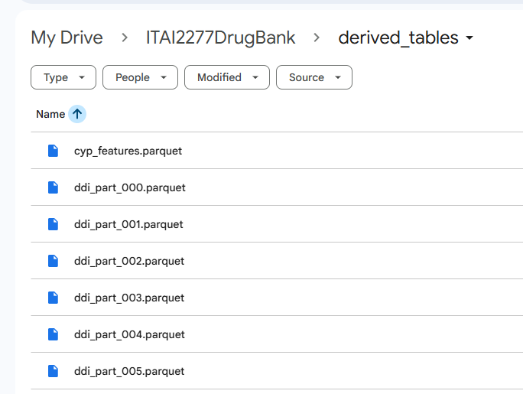
Week 4 | Data Acquisition & Collection
Project Goal:
Source provided a 1.76 GB XML file which we then processed using structure parsing in Google Colab
We extracted ONLY what we needed. This creates 4 compact tables that align with CompoundIQ needs
Selected because it aligns with project goal: drug combination safety analysis
TABLE | ROWS | SIZE | PURPOSE
drugs.parquet | 1,014,348 | 5.31 MB | Core drug metadata (from nested XML extraction)
drug_interactions.parquet | 2,910,010 | 55.15 MB | Drug-drug interaction relationships
targets.parquet | 24,231 | 0.56 MB | Drug-target associations
enzymes.parquet | 6,062 | 0.08 MB | Metabolic enzyme (CYP) data
Stored outputs as Parquet files in Google Drive folder for faster access and reduced storage.

Slide 4
Week 4 | Data Acquisition & Collection
WEEK 4
Additional Datasets
# Download & verify all datasets
datasets = {
'ChEMBL': 'data/raw/chembl_molecules.csv',
'SIDER': 'data/raw/sider.csv',
'ZINC': 'data/raw/zinc_druglike.smi'
}
for name, path in datasets.items():
size = os.path.getsize(path)/(1024*1024)
df = pd.read_csv(path)
print(f"✅ {name} | {size:.1f}MB | {len(df):,} records")
TWOSIDES: 738 MB · Adverse drug event pairs (NSIDES)
SIDER: 309,849 records · Drug side effect database
ChEMBL: 50,000 records · Molecular bioactivity data
ZINC: Drug-like molecules from clinical trials
Data Collection Verification Script

Slide 5
Data Pipeline Architecture
WEEK 4
DrugBank XML
(1.76 GB)
Stream-parsed to avoid
loading 1.76 GB into memory
▼
XML Parsing
(Structured Extraction)
4 tables aligned to
CompoundIQ project goals
url = "http://sideeffects.embl.de/media/download/meddra_all_se.tsv.gz"
df_sider = pd.read_csv(url, sep='\t', compression='gzip',
names=['stitch_id_flat','stitch_id_stereo',
'umls_id','side_effect','meddra_type'])
df_sider.to_csv('data/raw/sider.csv', index=False)
# ✅ SIDER: 309,849 side effect records
▼
Structured Parquet Tables
drugs | interactions | targets | enzymes
Parquet format: faster
access, reduced storage
▼
Organized Data Storage
(Ready for Feature Engineering)
Stored in Google Drive
for team collaboration
SIDER Download Code
Raw biomedical XML successfully transformed into structured, reusable datasets.

Slide 6
Week 5 | Data Preprocessing & Feature Engineering
WEEK 5
Engineered Features Capturing:
Data Cleaning
Initial extraction: ~1M rows (duplicated entries from XML parsing)
Reduced to ~19K unique drugs (one row per DrugBank ID)
Standardized data types & handled missing values
Interaction Features
Metabolic (CYP) Features
Safety Complexity Score
Feature: total_interactions
What it measures: Number of documented drug–drug interactions per compound
Why: Higher interaction counts suggest greater pharmacological complexity and safety considerations
Feature: n_unique_cyp
What it measures: Number of unique cytochrome P450 enzymes associated with a drug
Why: CYP enzymes drive drug metabolism; more CYP involvement increases variability and interaction risk
Feature: safety_complexity_score
What it measures: Composite metric combining interaction burden and metabolic diversity
Why: Creates a normalized summary measure of pharmacological safety complexity

Slide 7
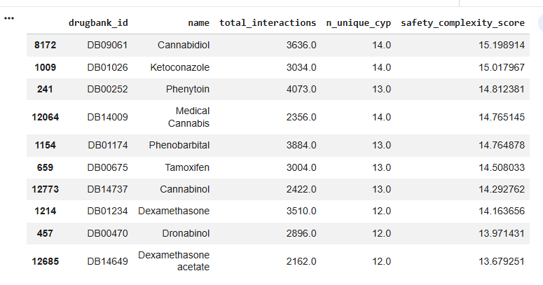
Week 5 | Data Preprocessing & Feature Engineering - Example
“Top Safety Complexity (not intrinsic danger)”
The highest scoring drugs correspond to well-known interaction-heavy medications, suggesting the engineered safety complexity score aligns with real pharmacological knowledge.

Slide 8
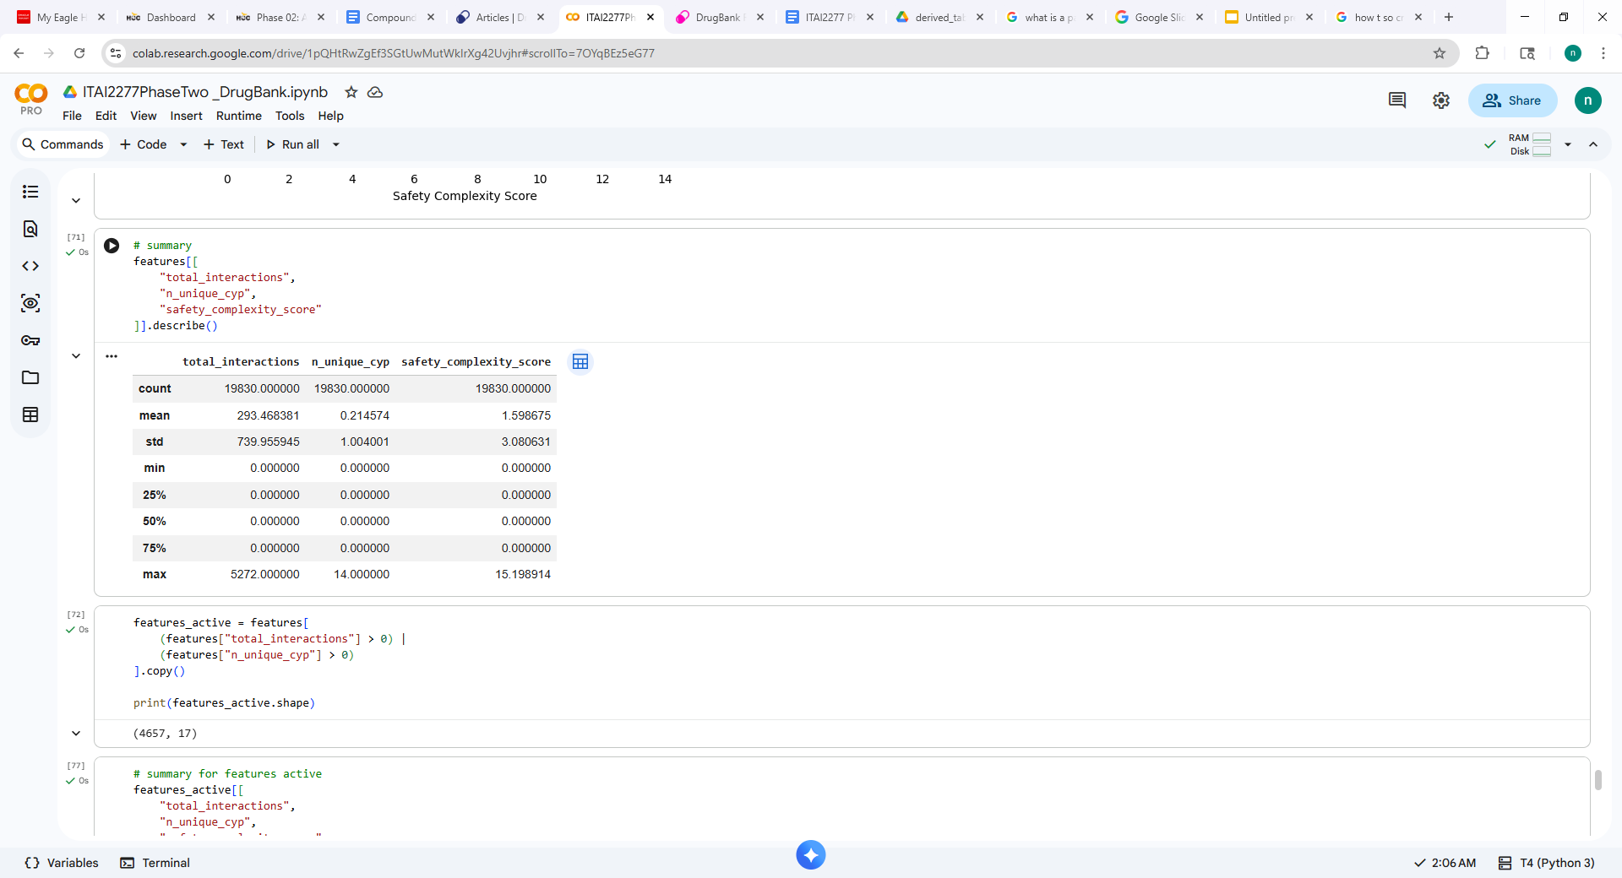
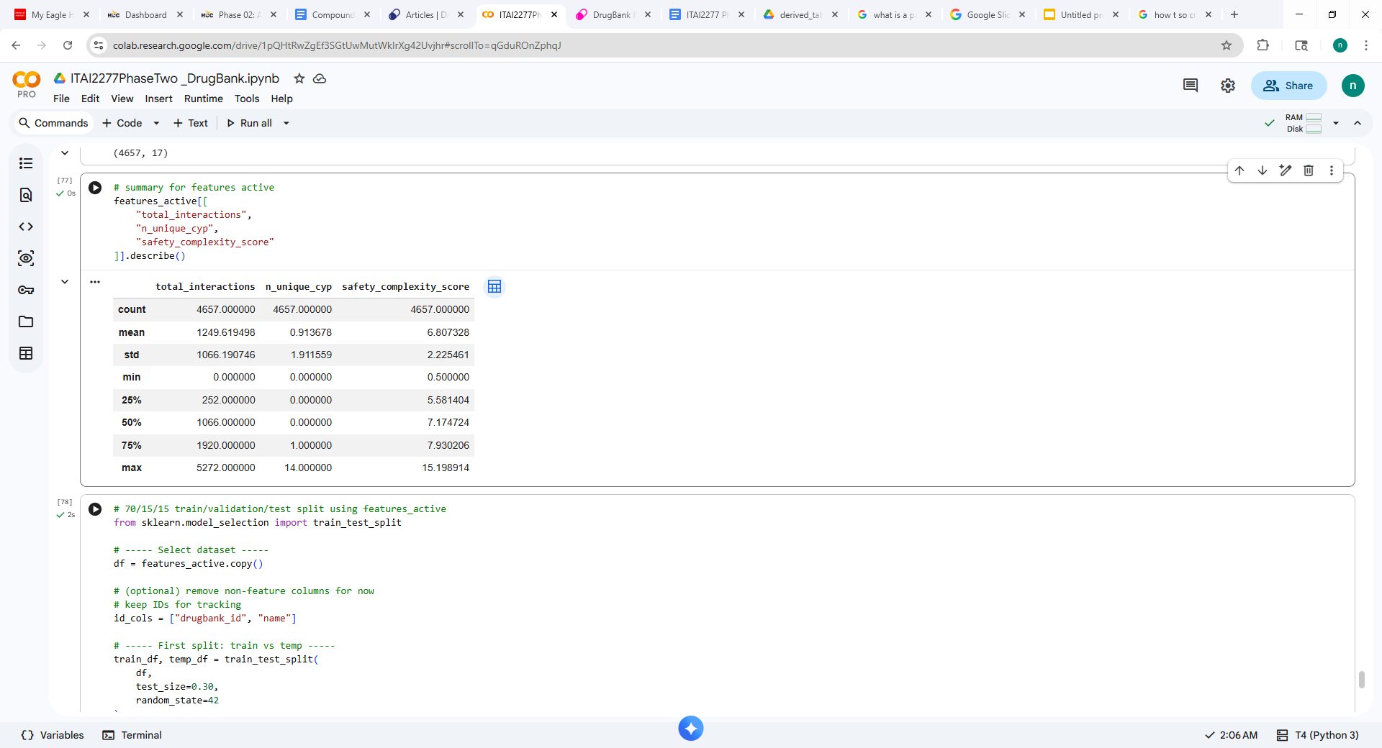
Week 5 | Data Preprocessing & Feature Engineering
After merging engineered features into a unified feature table (19,830 drugs), we observed strong sparsity: many drugs contained limited safety data. To focus on informative compounds, we created a filtered subset called 'features_active', containing 4,657 drugs with meaningful interaction or CYP information.
Finally, we implemented a 70/15/15 train-validation-test split to prepare the dataset for future predictive modeling
FULL dataset
ACTIVE dataset
Full Dataset:
19,830 drugs
Active Subset:
4,657 drugs
Train Split:
70%
Val / Test:
15% / 15%
Max Interactions:
5,272
Max Unique CYP:
14

Slide 9
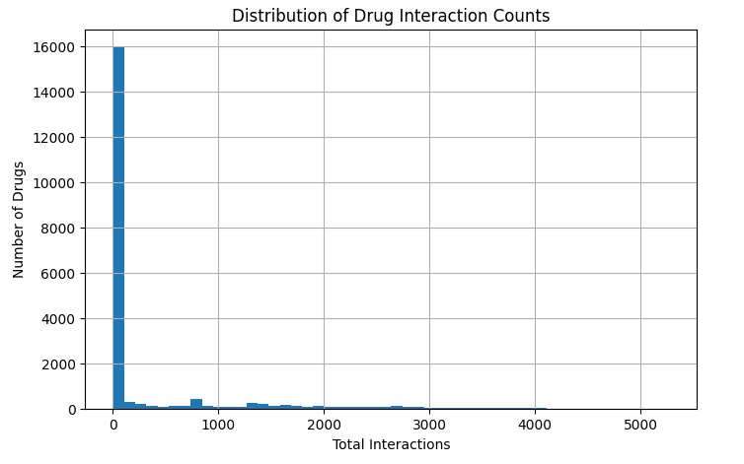
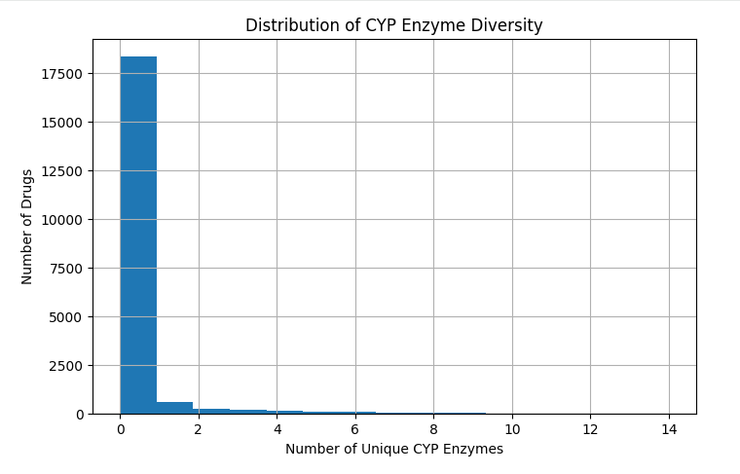
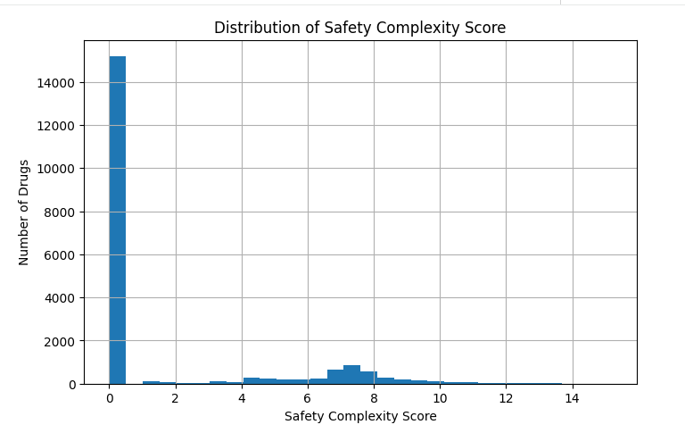
Week 6 | Exploratory Data Analysis - FULL dataset
WEEK 6
Drug Interaction Distribution
CYP Enzyme Diversity
Safety Complexity Score
Most drugs have zero or few interactions; a small subset is highly connected — classic long-tail behavior.
Many drugs involve no CYP pathways. A smaller subset shows high metabolic complexity (up to 14 unique enzymes).
Combined feature cleanly separates high-complexity drugs (e.g., Cannabidiol, Ketoconazole) from the majority.

Slide 10
Data Characteristics: Sparsity & Long-Tail Behavior
Sparsity
Long-Tail Distribution
Large number of drugs with zero or near-zero recorded interaction/metabolism data.
A small subset of highly studied drugs accounts for most documented interactions and annotations.
Why Sparsity Occurs
Why Long-Tail Occurs
Experimental & newly studied compounds
Rare or discontinued drugs
Niche therapeutics with limited research
Insufficient annotation coverage
Research focuses on common & older drugs
Clinically important drugs accumulate citations
More reported interactions over decades
Regulatory attention drives annotation depth
Implication for CompoundIQ
Implication for CompoundIQ
Zero-imputation and active-drug subsetting (4,657 of 19,830) were applied to preserve signal quality.
Model training leverages well-annotated drugs while the pipeline remains extensible as annotations grow.

Slide 11
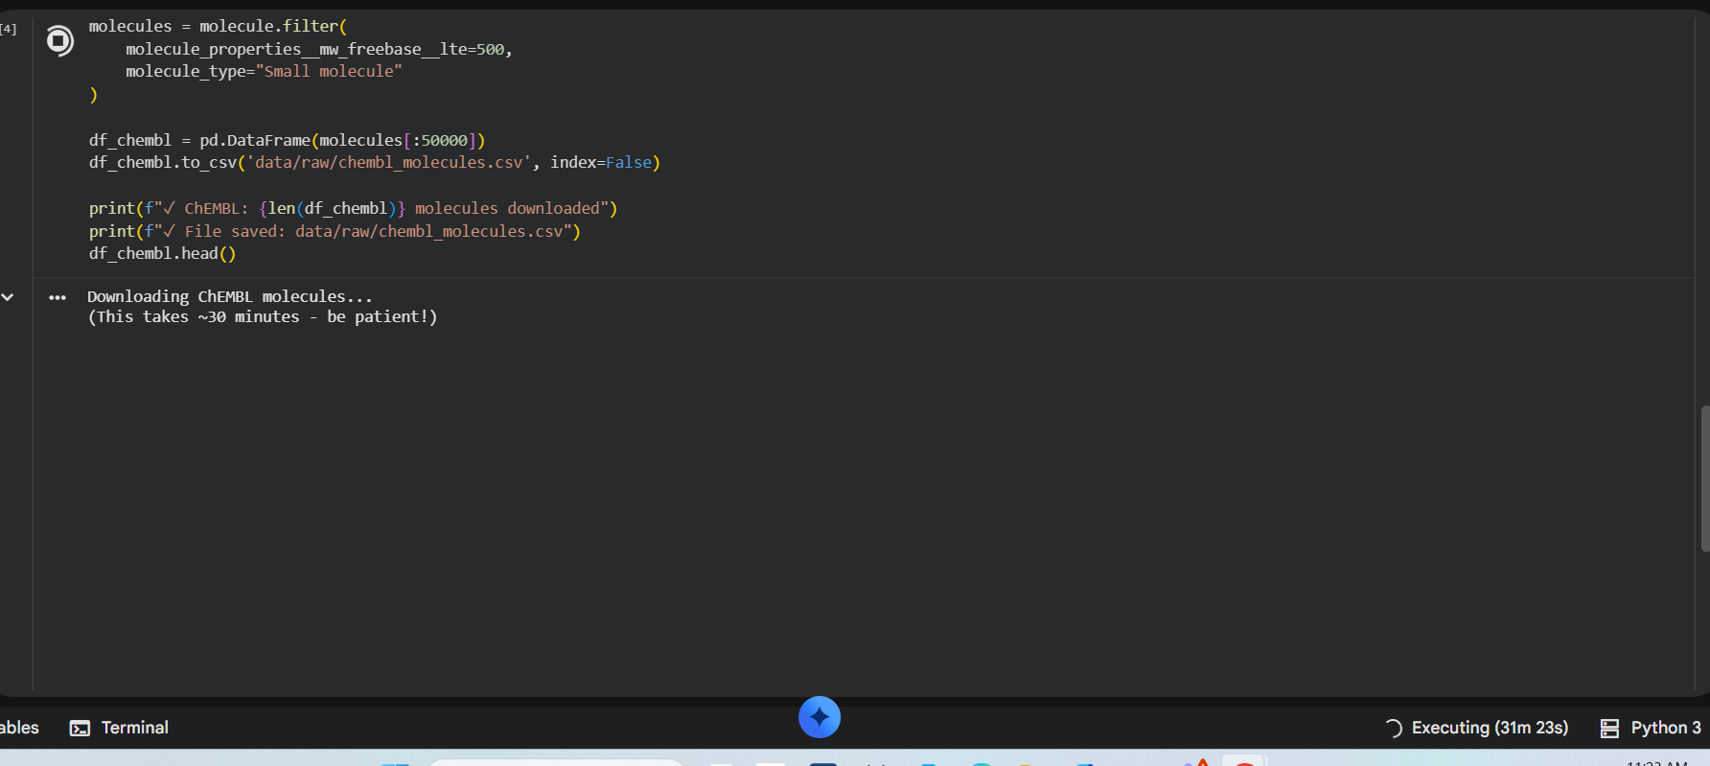
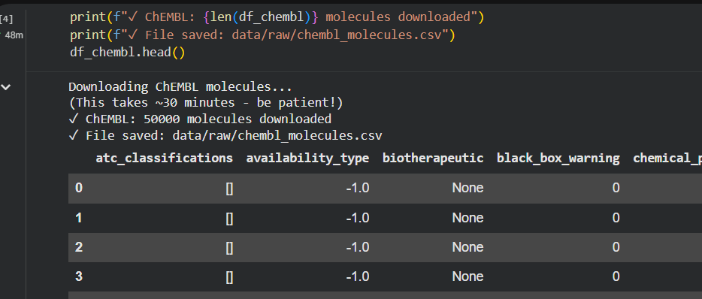
Code Deep-Dive | Key Implementation Snippets
ChEMBL Streaming Download (738 MB)
Feature Engineering Pipeline
url = "https://tatonettilab-resources.s3.amazonaws.com/nsides/TWOSIDES.csv.gz"
response = requests.get(url, stream=True)
total = int(response.headers.get('content-length', 0))
with open('data/raw/TWOSIDES.csv.gz', 'wb') as f:
with tqdm(total=total, unit='B', unit_scale=True) as pbar:
for chunk in response.iter_content(8192):
f.write(chunk)
pbar.update(len(chunk))
# Decompress to CSV
with gzip.open('data/raw/TWOSIDES.csv.gz', 'rt') as f:
df = pd.read_csv(f)
df.to_csv('data/raw/twosides.csv', index=False)
# Merge interaction counts from both directions
df_feats = (
df_interactions
.groupby('drugbank_id_subject')['drugbank_id_affected']
.count()
.reset_index()
.rename(columns={'drugbank_id_affected': 'n_as_subject'})
)
# Merge CYP enzyme counts
df_cyp = (
df_enzymes[df_enzymes['enzyme'].str.startswith('CYP')]
.groupby('drugbank_id')['enzyme']
.nunique()
.reset_index()
.rename(columns={'enzyme': 'n_unique_cyp'})
)
# Composite safety score
df['safety_complexity_score'] = (
np.log1p(df['total_interactions']) + df['n_unique_cyp']
)
Verification Output
============================================================
WEEK 4: DATA COLLECTION COMPLETE
============================================================
✅ ChEMBL | 144.9 MB | 50,000 records
✅ SIDER | 14.7 MB | 309,849 records
✅ ZINC | 0.0 MB | 7 molecules
============================================================
🎉 Week 4 Complete – 3 Datasets Ready!

Slide 12
Phase 2 Summary
Data Pipeline & Exploratory Analysis Complete
Week 4
3 primary datasets collected & organized (DrugBank, SIDER, ChEMBL)
Week 5
19,830 drugs cleaned; safety complexity score engineered; 70/15/15 split applied
Week 6
EDA confirms long-tail distributions; top complexity drugs validated against pharmacology
Next: Phase 3 – Model Development & Training
Nicole Marcial · Oluchi Obinna · Oyinade Balogun · Sharise Griggs | ITAI 2277 Spring 2026

Slide 13
Sources - https://dev.drugbank.com/guides/drugbank/citing
Knox C, Wilson M, Klinger CM, et al. DrugBank 6.0: the DrugBank Knowledgebase for 2024. Nucleic Acids Res. 2024 Jan 5;52(D1):D1265-D1275. doi: 10.1093/nar/gkad976.
Wishart DS, Feunang YD, Guo AC, Lo EJ, Marcu A, Grant JR, Sajed T, Johnson D, Li C, Sayeeda Z, Assempour N, Iynkkaran I, Liu Y, Maciejewski A, Gale N, Wilson A, Chin L, Cummings R, Le D, Pon A, Knox C, Wilson M. DrugBank 5.0: a major update to the DrugBank database for 2018. Nucleic Acids Res. 2017 Nov 8. doi: 10.1093/nar/gkx1037.
Law V, Knox C, Djoumbou Y, Jewison T, Guo AC, Liu Y, Maciejewski A, Arndt D, Wilson M, Neveu V, Tang A, Gabriel G, Ly C, Adamjee S, Dame ZT, Han B, Zhou Y, Wishart DS. DrugBank 4.0: shedding new light on drug metabolism. Nucleic Acids Res. 2014 Jan 1;42(1):D1091-7.
Knox C, Law V, Jewison T, Liu P, Ly S, Frolkis A, Pon A, Banco K, Mak C, Neveu V, Djoumbou Y, Eisner R, Guo AC, Wishart DS. DrugBank 3.0: a comprehensive resource for 'omics' research on drugs. Nucleic Acids Res. 2011 Jan;39(Database issue):D1035-41.
Wishart DS, Knox C, Guo AC, Cheng D, Shrivastava S, Tzur D, Gautam B, Hassanali M. DrugBank: a knowledgebase for drugs, drug actions and drug targets. Nucleic Acids Res. 2008 Jan;36(Database issue):D901-6.
Wishart DS, Knox C, Guo AC, Shrivastava S, Hassanali M, Stothard P, Chang Z, Woolsey J. DrugBank: a comprehensive resource for in silico drug discovery and exploration. Nucleic Acids Res. 2006 Jan 1;34(Database issue):D668-72.
Nicole Marcial · Oluchi Obinna · Oyinade Balogun · Sharise Griggs | ITAI 2277 Spring 2026

